Slide 1
Analyzing Consumer Sentiment of Future Trends in the Economy
Jack Boydell, David Richardson, Madeline Van Slyke, Alex Bamberger

Slide 2

Business Application/Background
Top performing organizations are “consumer centric” in the sense that they focus on understanding what the consumer values and work to satisfy their needs and desires.
“The purpose of business is to create and keep a customer.” - Peter Drucker

Slide 3

Smart Consumer Model
belief that consumers understand their own notions of utility (preferences) and how to navigate the marketplace to achieve what they want
learn from mistakes, skeptical
utilize appropriate information
economically literate!
Extension question: Can the idea of a “smart consumer” be extended to general economic indicators like unemployment and interest rates?

Slide 4
Question/Purpose
Overarching question: Do consumer’ opinions and sentiment provide insight into being able to classify the change in unemployment and/or interest rates in a years time?
Two areas of analysis:
Ranges in our data:
3.5% - 14.7 %
Unemployment Rates: the percentage of the labor force that is unemployed and actively seeking employment
Interest Rates (Federal Funds Rate): the target rate that the Fed sets for depository institutions (banks) to lend to one another, acts as a benchmark that other interest rates follow in lock step
0.25% - 14 %

Slide 5
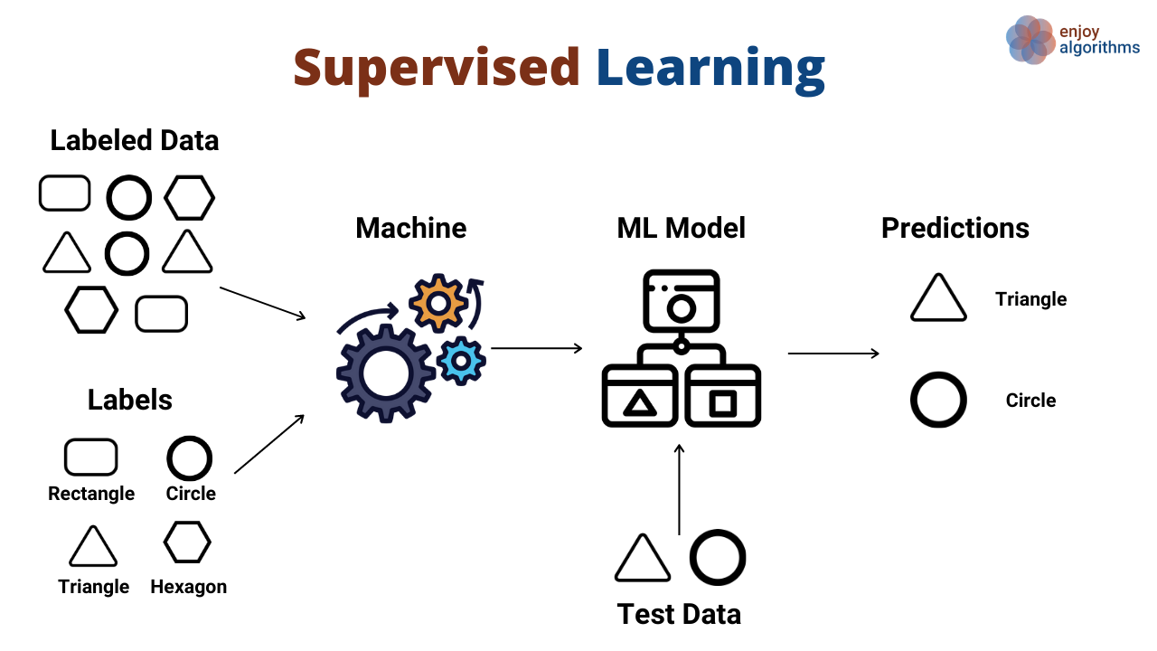
Machine Learning Overview
Machine Learning: the use of various algorithms to learn from and make predictions on data, programs learn and execute without explicitly programmed instructions
Supervised Learning: working with labeled data to predict or classify a designated target variable, two flavors: regression and classification
Classification: modeling the class of a categorical target variable with features, binary or multiclass

Slide 6



Data Sources
University of Michigan - Consumer Sentiment Index, Survey of Consumers
2. U.S. Bureau of Labor Statistics - Unemployment Rate Data
3. Federal Reserve Bank of St. Louis - Federal Funds/Interests Rates
Literature: mixed results about the predictive power of the Survey of Consumers, no approach taken from a Machine Learning (classification) perspective

Slide 7
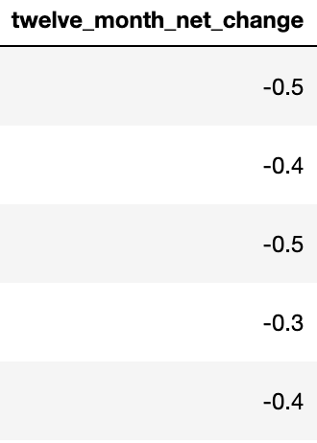
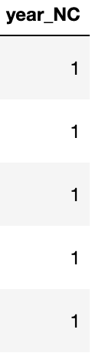
Consumer Sentiment ~ Unemployment
Model: Logistic Regression Classifier
Understanding Logistic Regression:
creates a linear decision boundary that divides data into two distinct groups, above and below the line
Feature Engineering

Slide 8
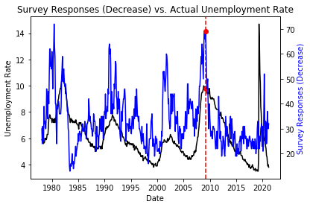
Exploratory Data Analysis
Time series comparison of survey counts for “go down”/decreasing vs. unemployment rate:

Slide 9
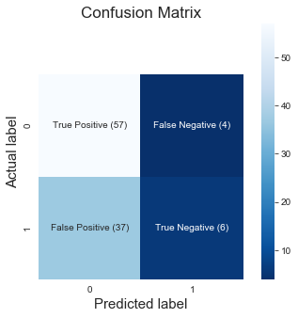
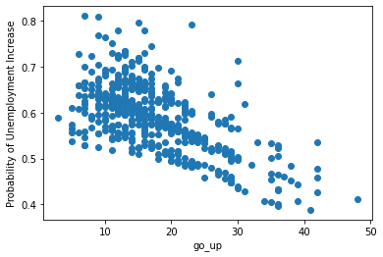
Modeling/Results ~ Unemployment Rates
overall low classification accuracy (~.6)
promising results in correctly classifying the an increasing/no change rate (see recall)
Predictions of Increasing Unemployment v.s. Modeled Probability of Unemployment Increase
Performance Metrics:
Accuracy score = 0.606
Precision = 0.61
Recall = 0.93
Notes:
Algorithms investigated: Logistic regression with Grid Search CV, Linear SVM Classifier, Decision Tree Classifiers (with Bagging and Gradient Boosting)

Slide 10
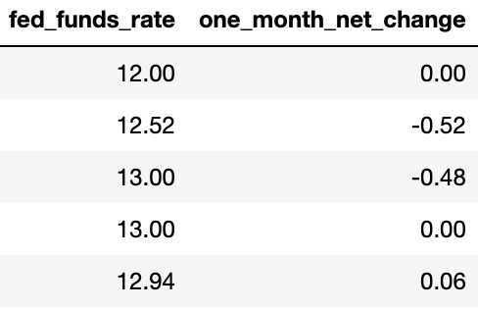
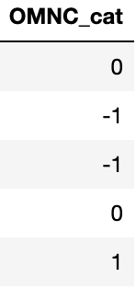
Consumer Sentiment ~ Interest Rates
Model: Linear Support Vector Machine (SVM)
Understanding Linear SVM:
creates linear decision boundary
maximizes margin between classes
tries to minimize misclassification
Feature Engineering

Slide 11
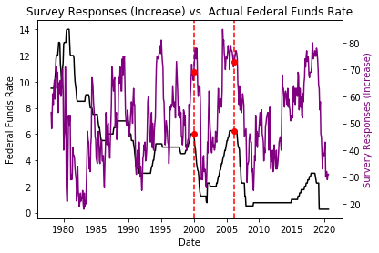
Exploratory Data Analysis
Time series comparison of survey counts for “go up”/increasing vs. federal funds rate:

Slide 12
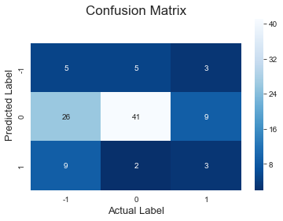
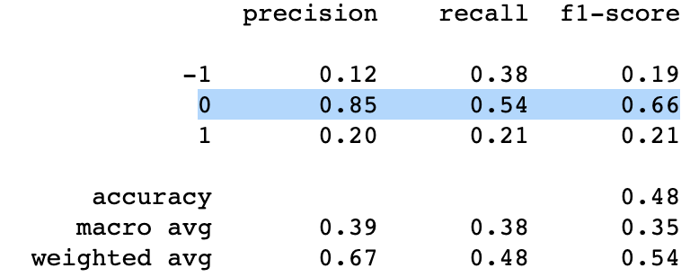
Modeling/Results ~ Interest Rates
initial accuracy ~.7 with logistic regression
we discovered the model was predicting all observations as stagnant, dominant class
after balancing the class weights, SVM gave an accuracy ~0.55
better at classifying stagnant interest rates than increasing or decreasing interest rates
*no change (“0” class) highlighted below
Performance Metrics:
Accuracy score = 0.553
Avg. Precision = 0.39
Avg. Recall = 0.38
Notes:
Early results indicated that consumer sentiment does a better job of classifying interest rates than unemployment rates (with an accuracy around .7) when using logistic regression. However, we discovered the model was predicting all observations as increasing. Because there were many months when the interest rate did not change after many months

Slide 13
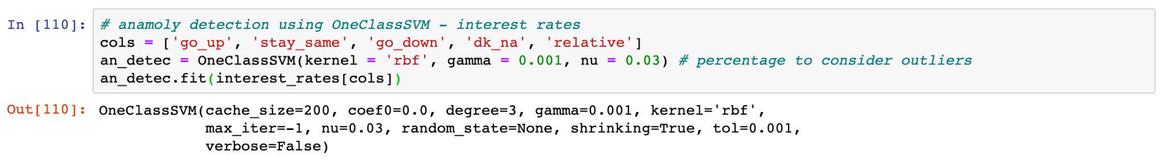
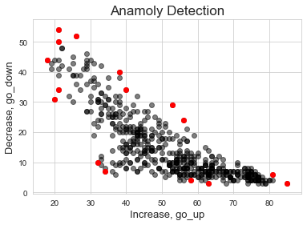
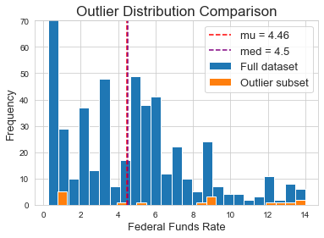
Anomaly/Outlier Detection
An example of unsupervised learning using one class support vector machine to identify anomalies in survey responses.

Slide 14
Review/Conclusion
overall low classification accuracy
models based on only consumer survey responses should not be used on their own
could be used in tandem with other sources of information
utilized effective anomaly detection

Slide 15
Thank you! Questions?

